Slide 2
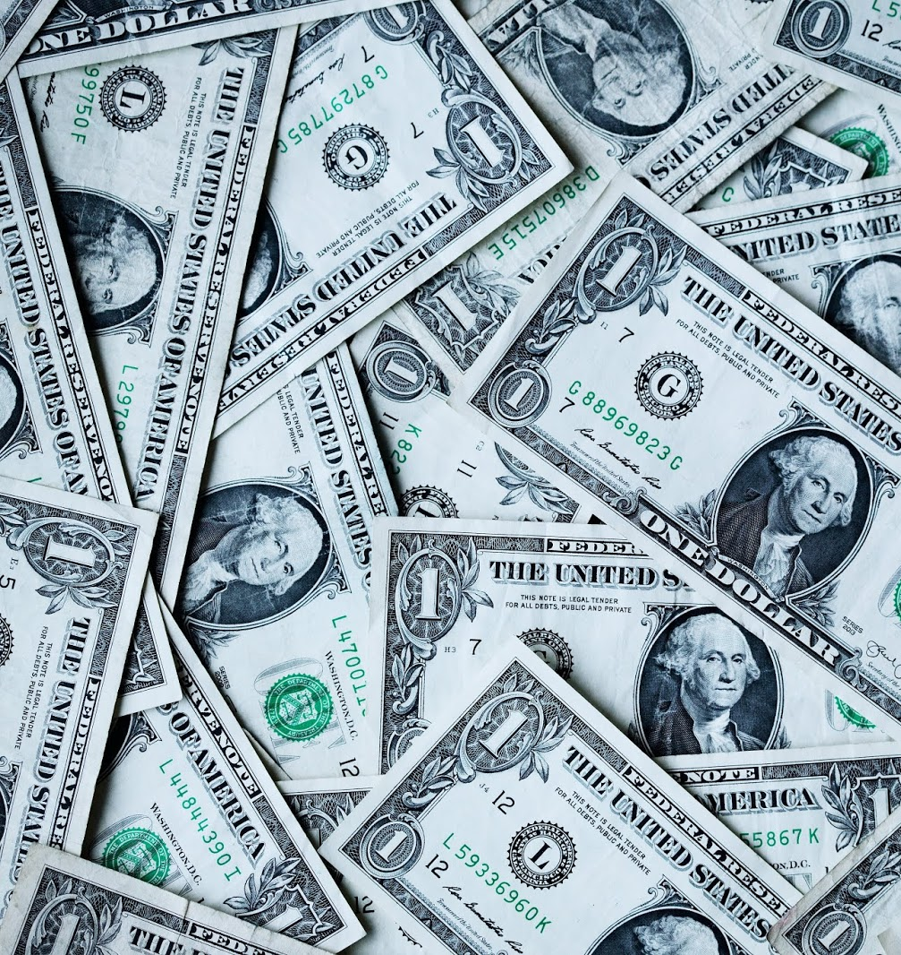
UNIT 6: MONEY
SPEAKING
PHOTO COMPARISON AND PRESENTATION

Slide 4
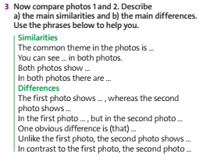

Slide 7
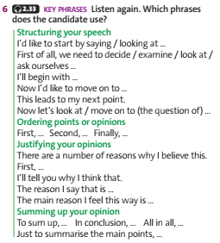
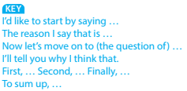

Slide 9
1/ Learn by heart all new vocabulary, phrases, and structures.
2/ Prepare for the next lesson.

Slide 10
THANK YOU
FOR YOUR ATTENTION

